Slide 1






Slide 2
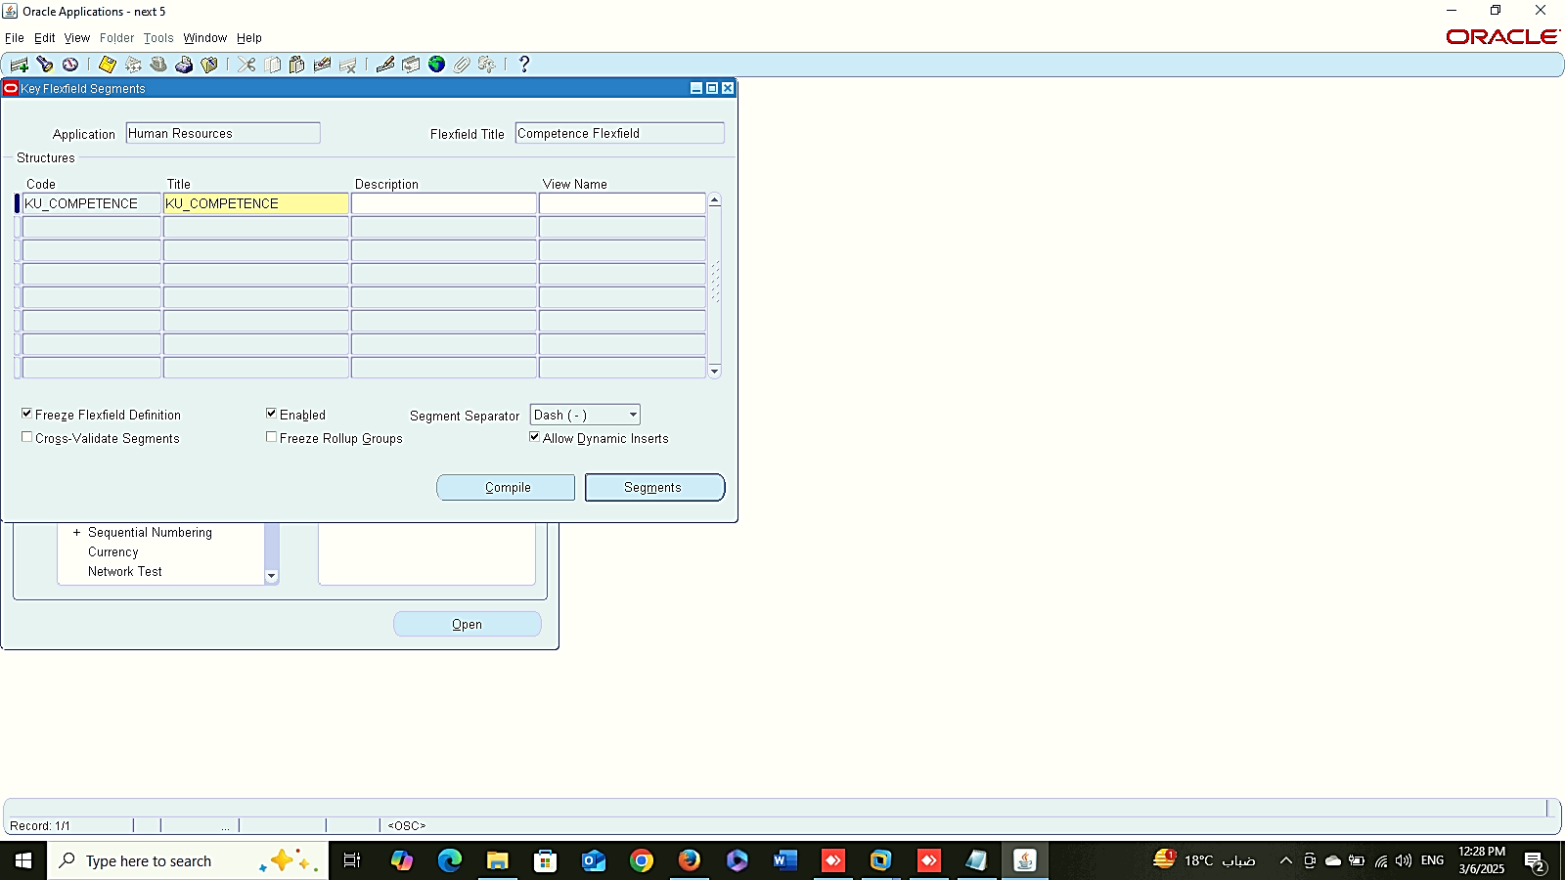
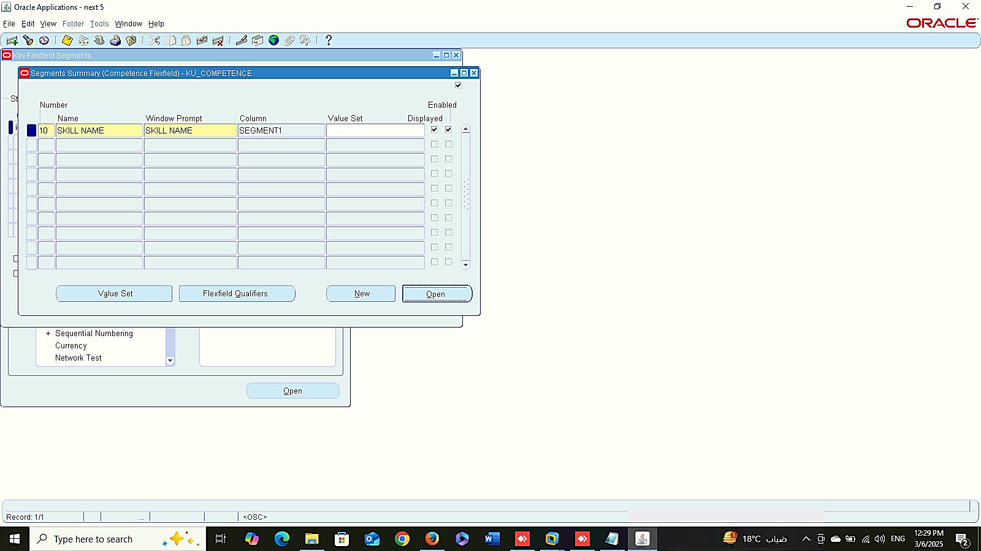
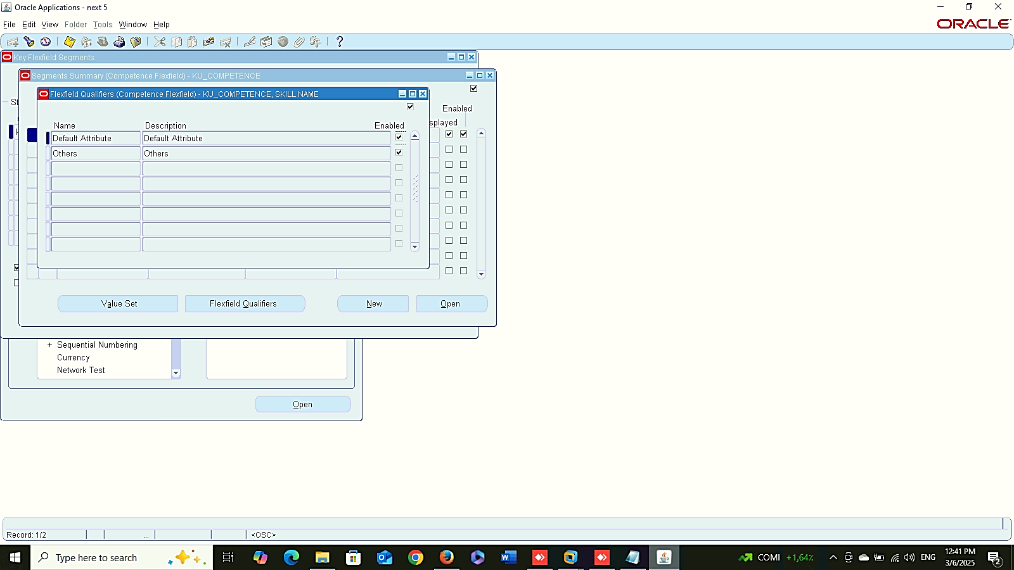
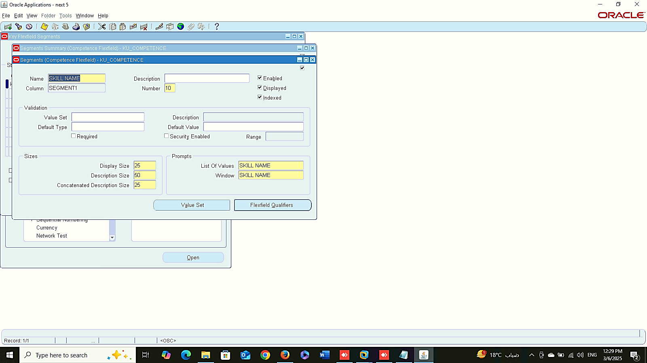
1
2
Work Structure
Setup
Create 6 Key Flex-field:
system administrator > Application > FLEXFIELD > KEY > SEGMENTS
Competences
Application > HUMAN RESOURCE > FLEXFIELD TITLE > COMPETENCE
3
4

Slide 3
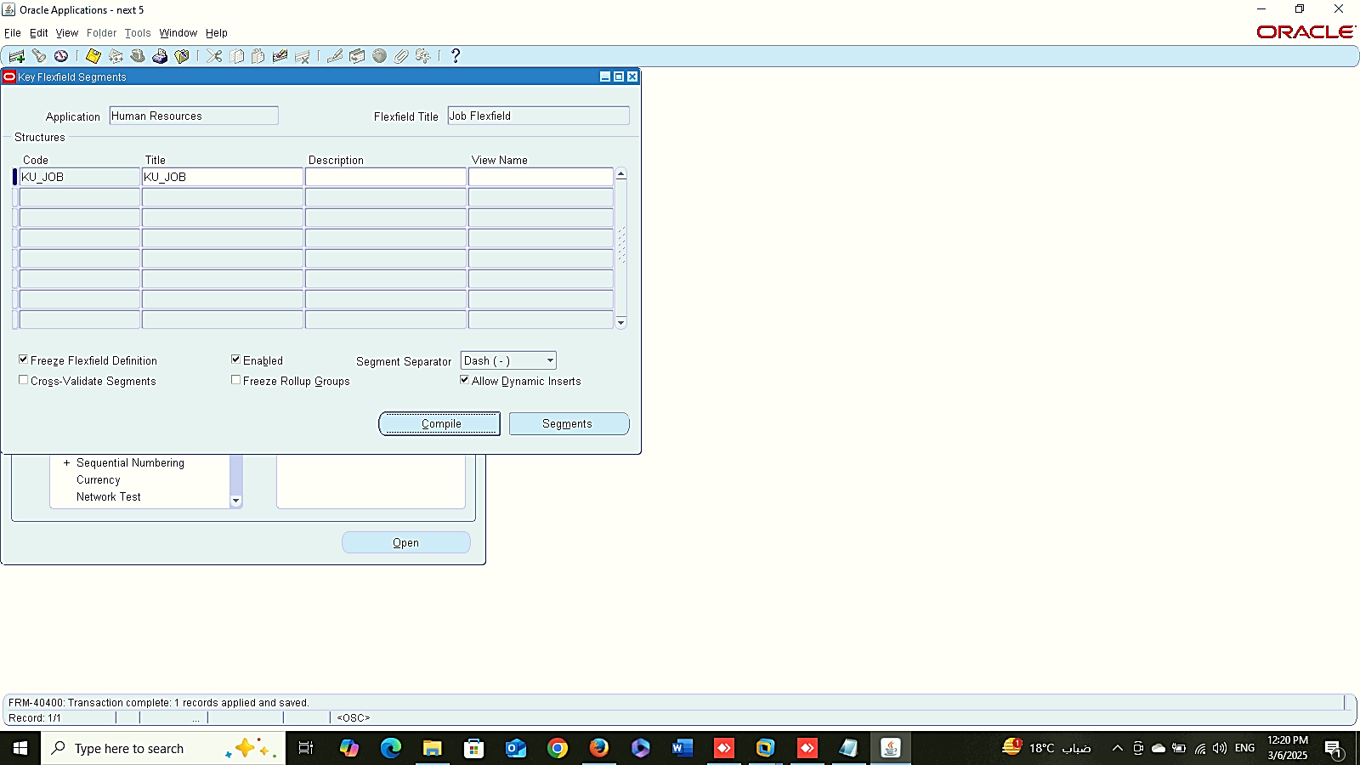
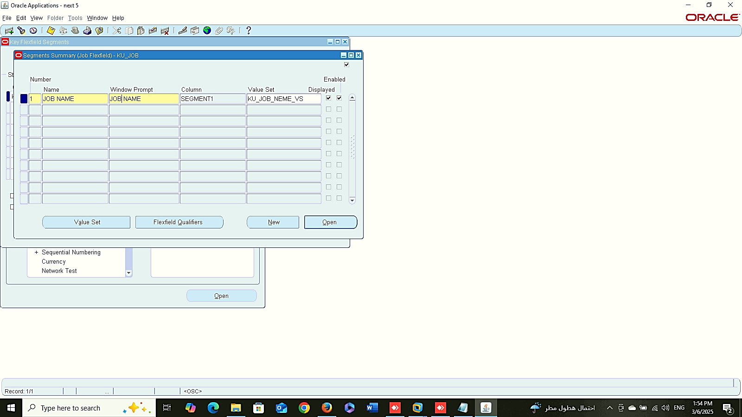
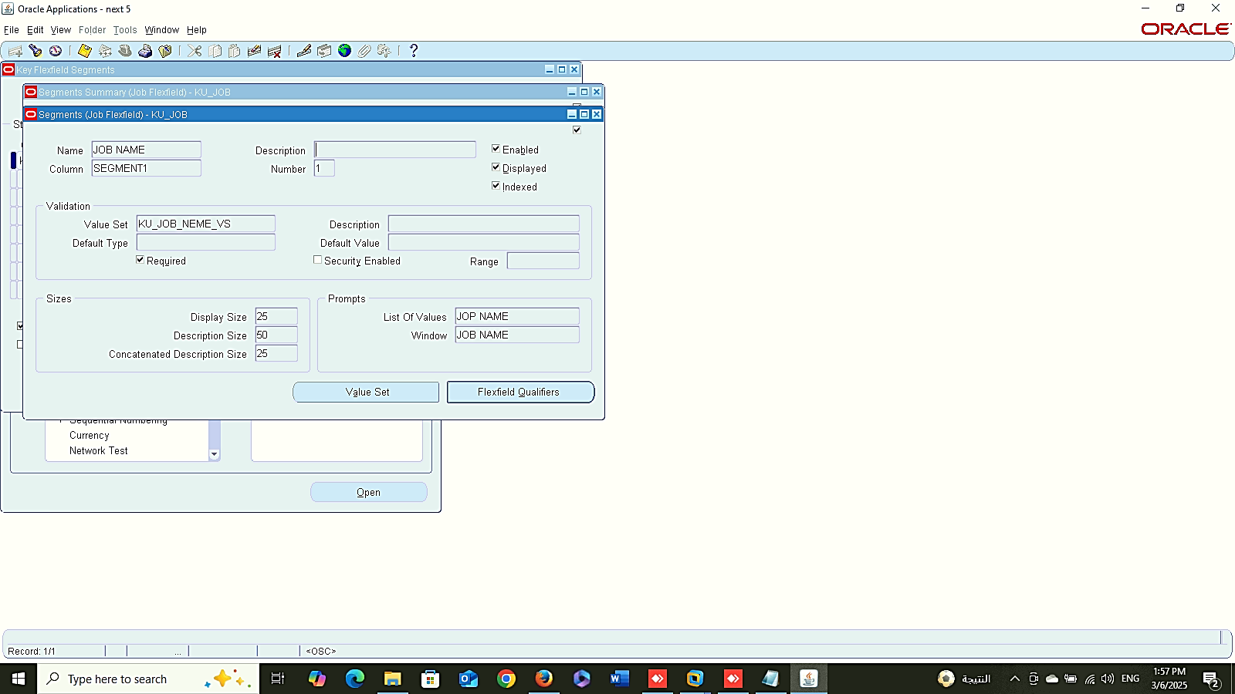
1
2
Work Structure
Setup
Create 6 Key Flex-field:
system administrator > Application > FLEXFIELD > KEY > SEGMENTS
Job
Application > HUMAN RESOURCE > FLEXFIELD TITLE > JOB
3

Slide 4
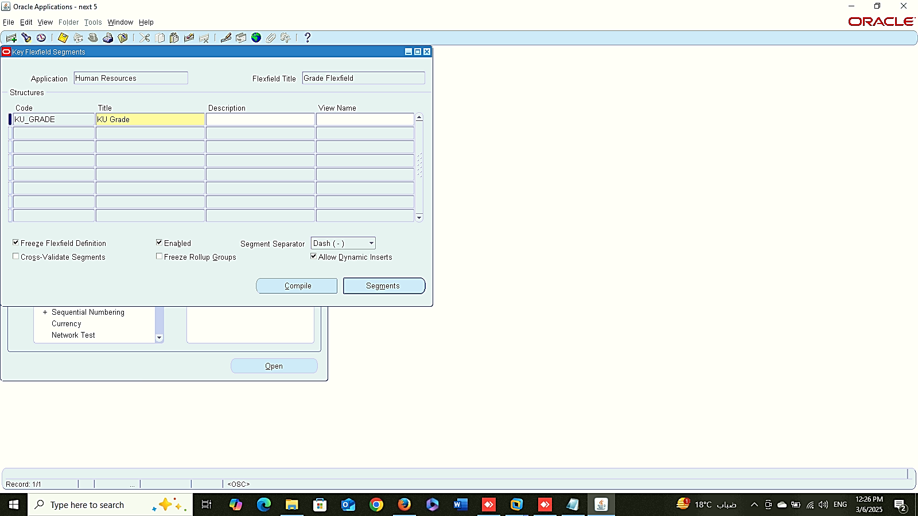
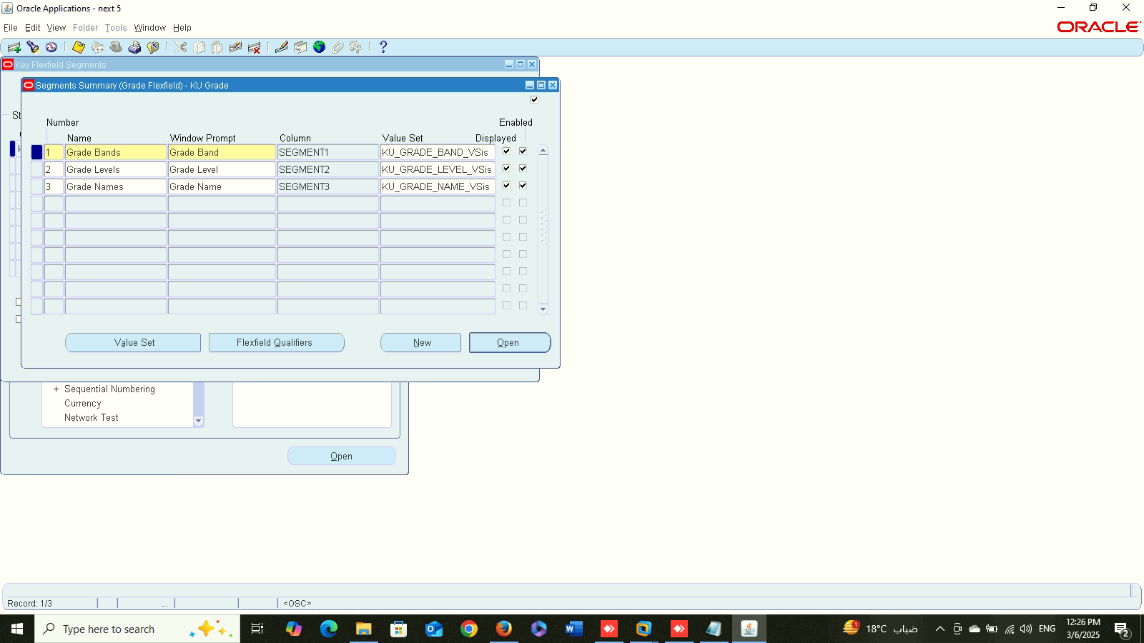
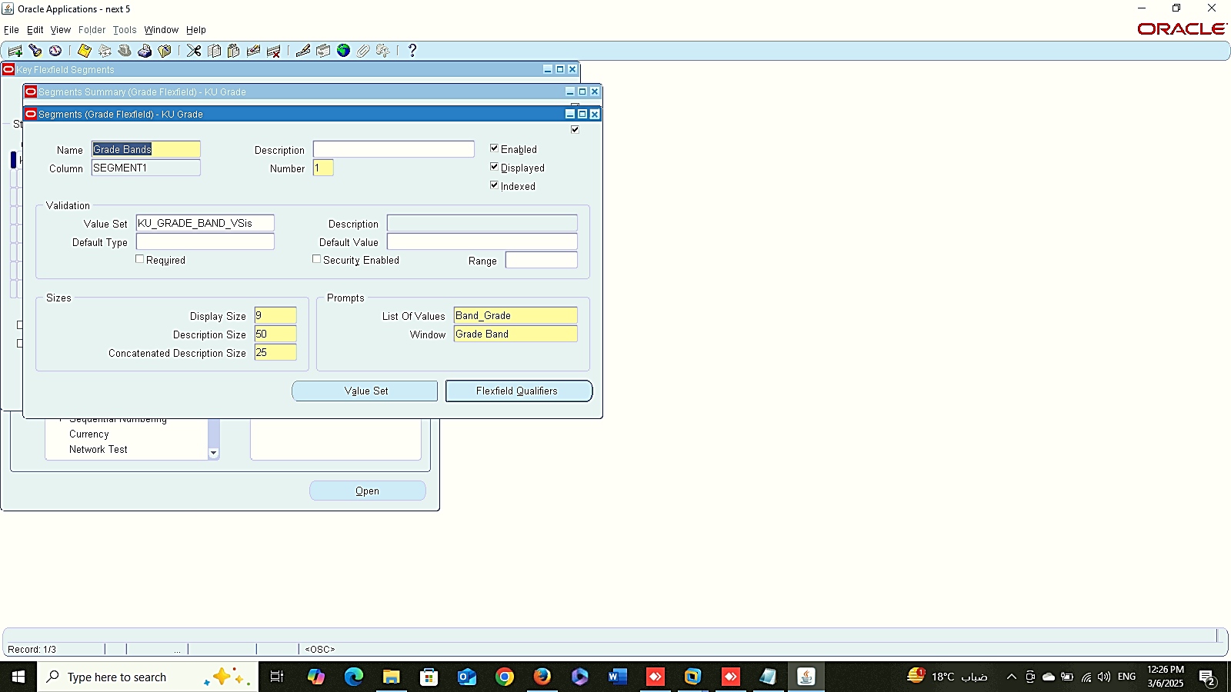
1
2
Work Structure
Setup
Create 6 Key Flex-field:
system administrator > Application > FLEXFIELD > KEY > SEGMENTS
Grade
Application > HUMAN RESOURCE > FLEXFIELD TITLE > GRADE
3

Slide 5
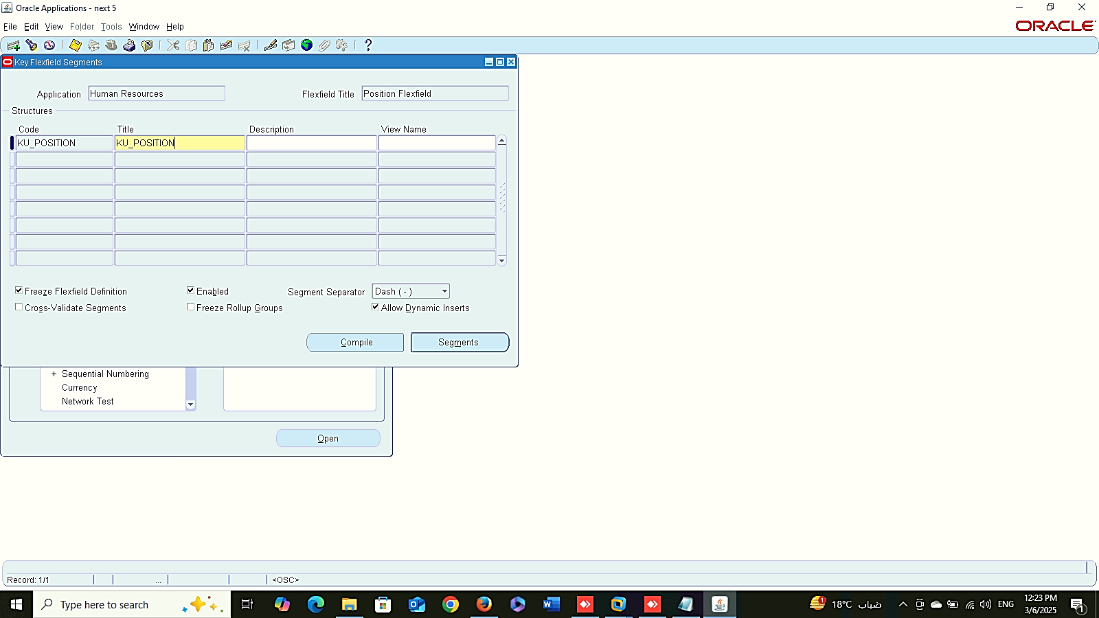
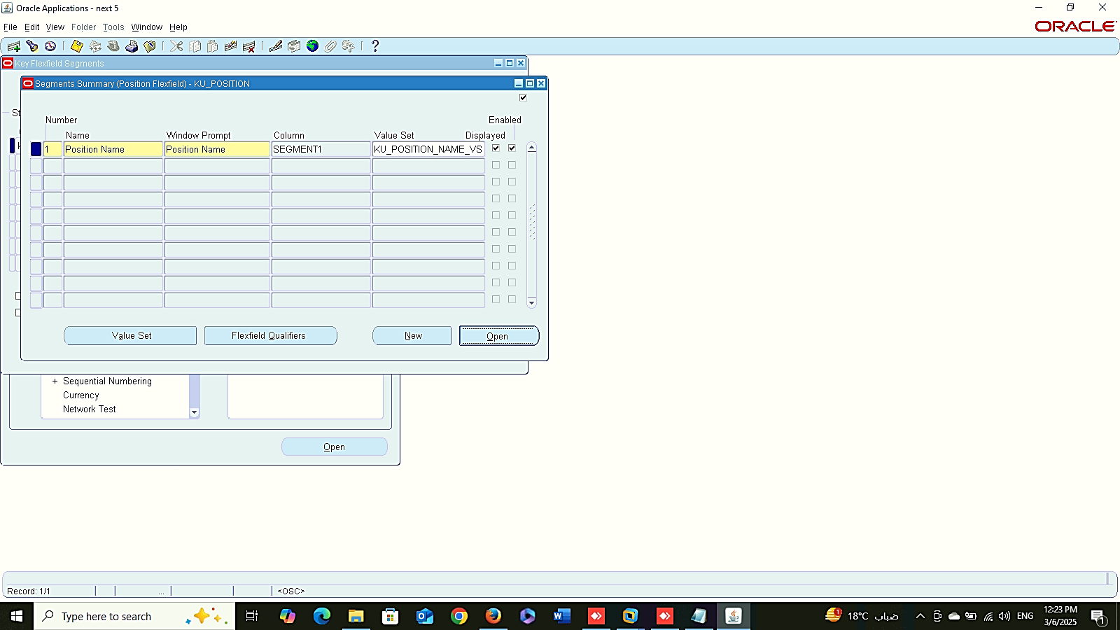
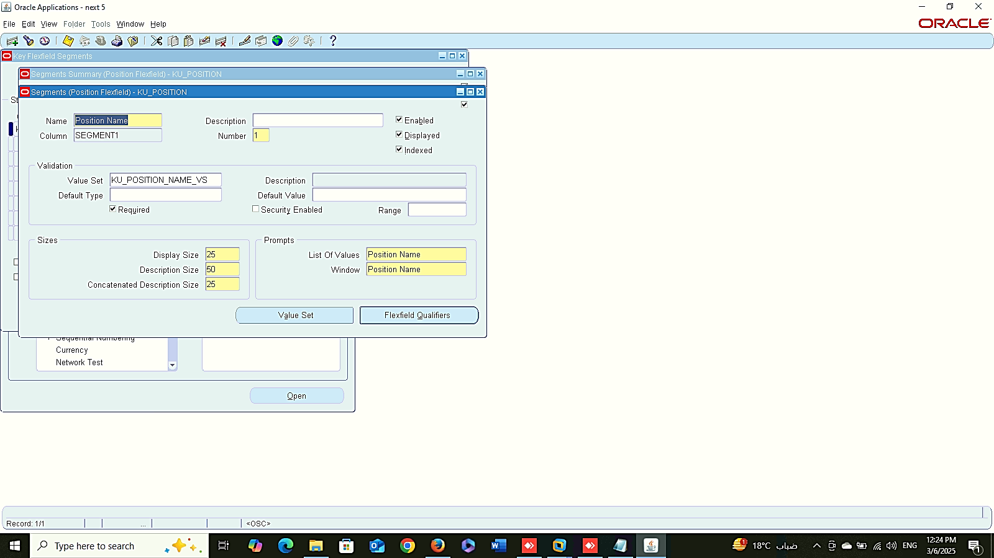
1
2
Work Structure
Setup
Create 6 Key Flex-field:
system administrator > Application > FLEXFIELD > KEY > SEGMENTS
Position
Application > HUMAN RESOURCE > FLEXFIELD TITLE > POSITION
3

Slide 6
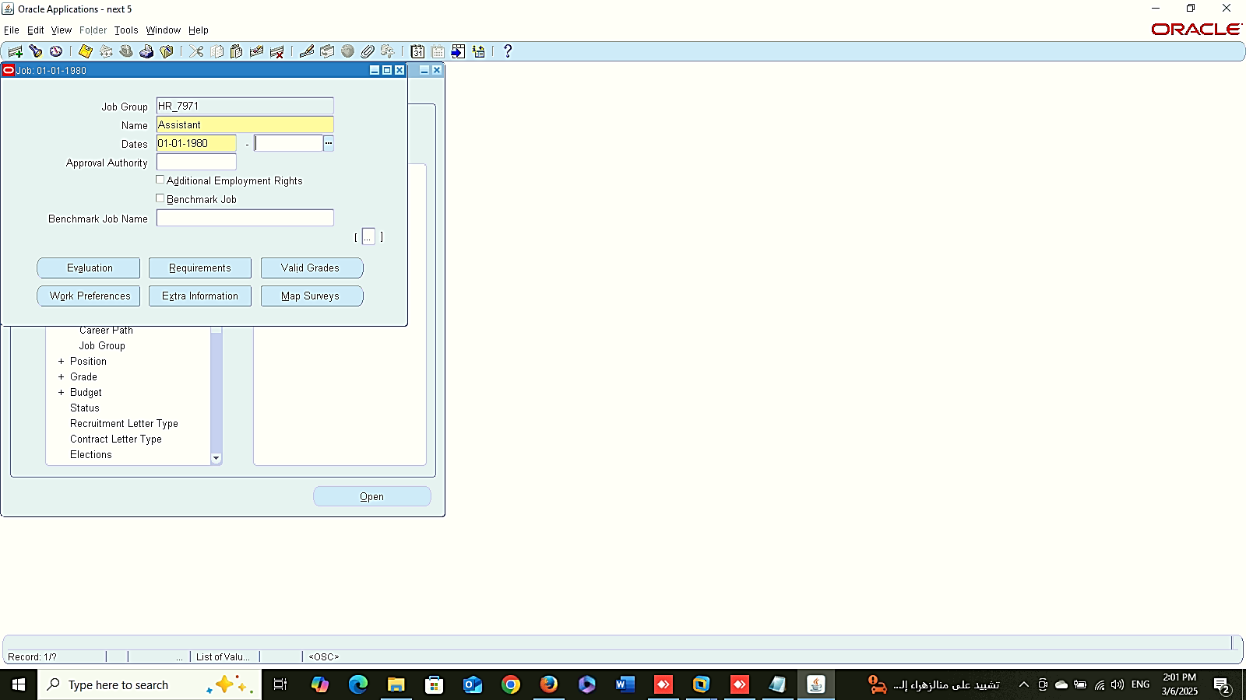
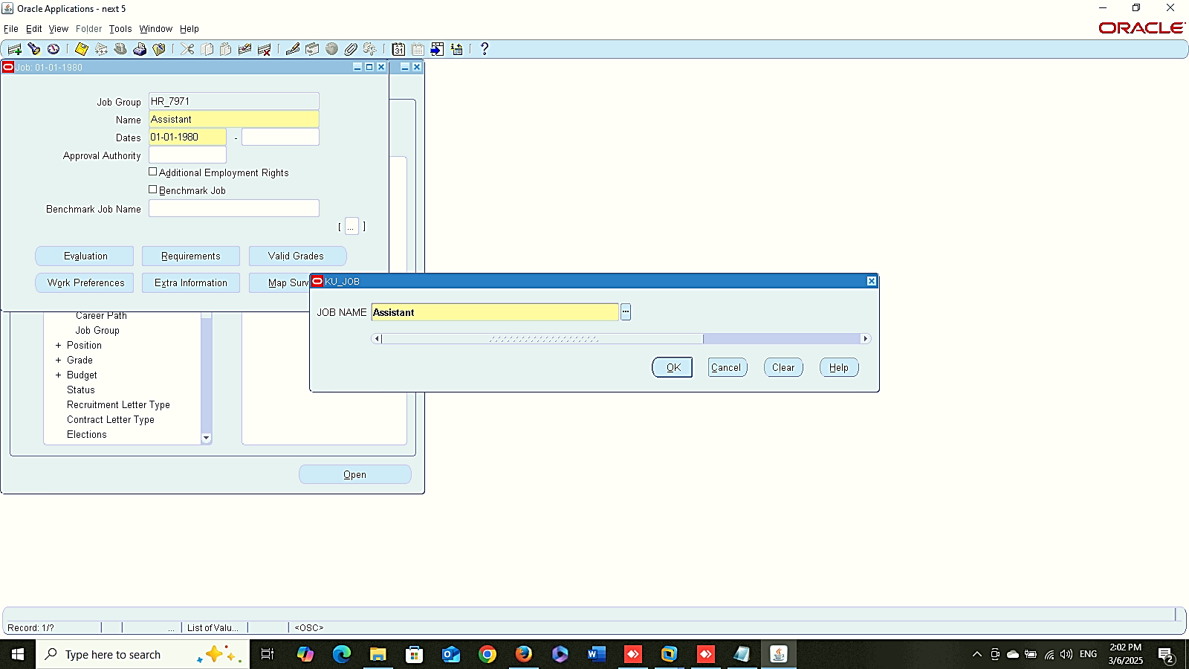
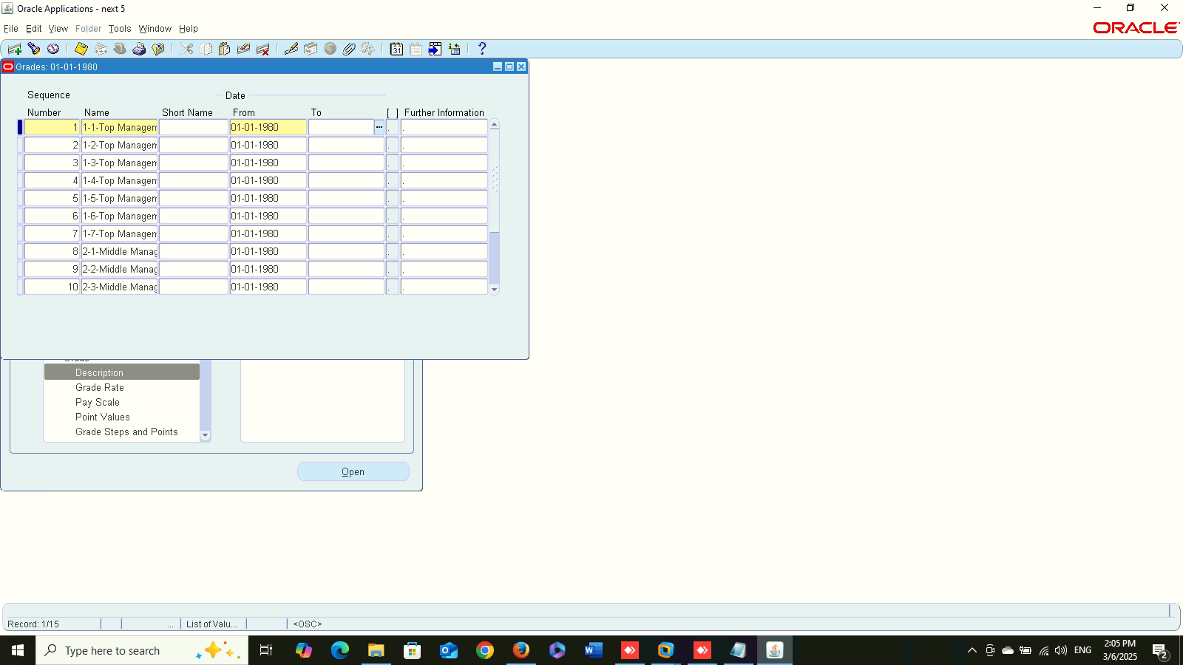
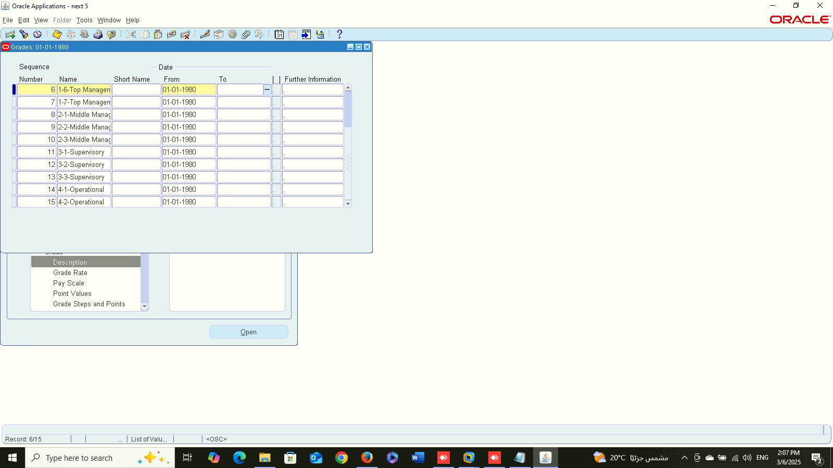
Define Job
1
2
Work Structure
Setup
Define Job:
Global HRMS MANAGER > WORK STRUCTURE > JOB > DESCRIPTION
Define Grade:
Global HRMS MANAGER > WORK STRUCTURE > GRADE > DESCRIPTION
Valid Grade:
Global HRMS MANAGER > WORK STRUCTURE > JOB > DESCRIPTION
Define Grade
1
2

Slide 7
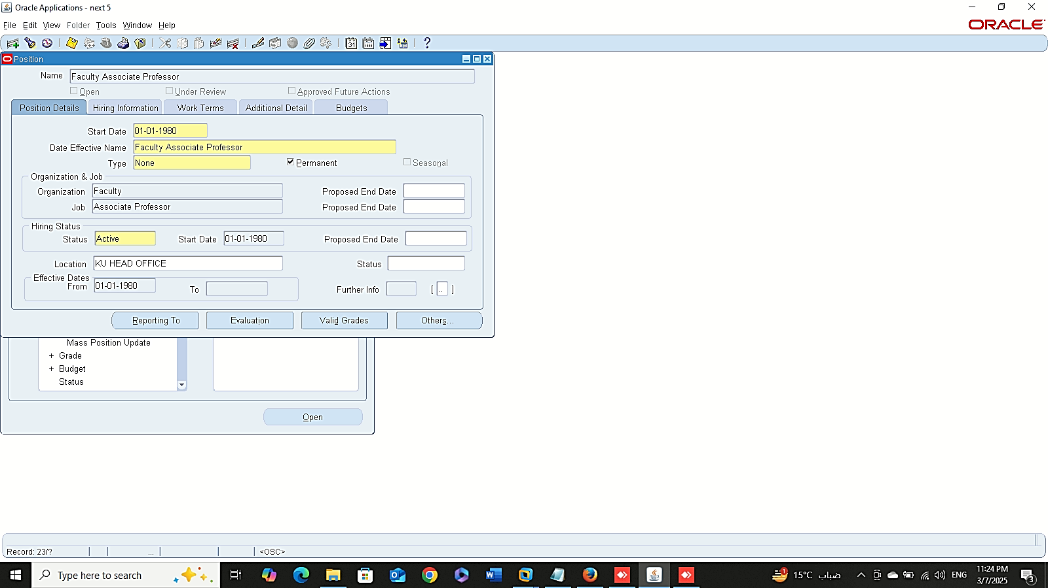


Define Position
1
2
Work Structure
Setup
Define Position:
Global HRMS MANAGER > WORK STRUCTURE > POSITION > DESCRIPTION
3

Slide 8
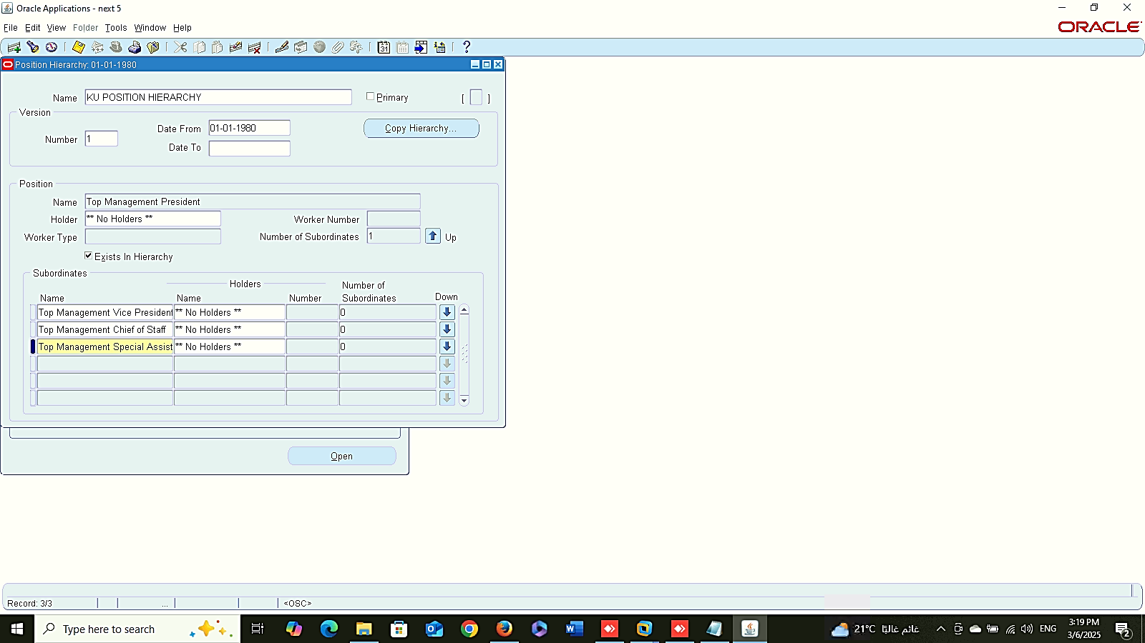
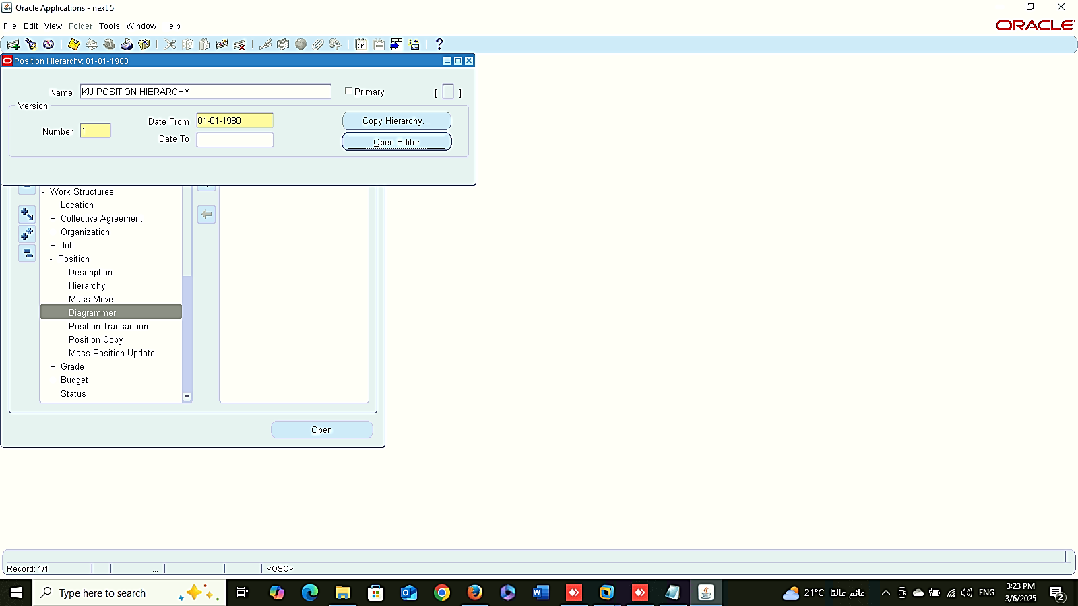
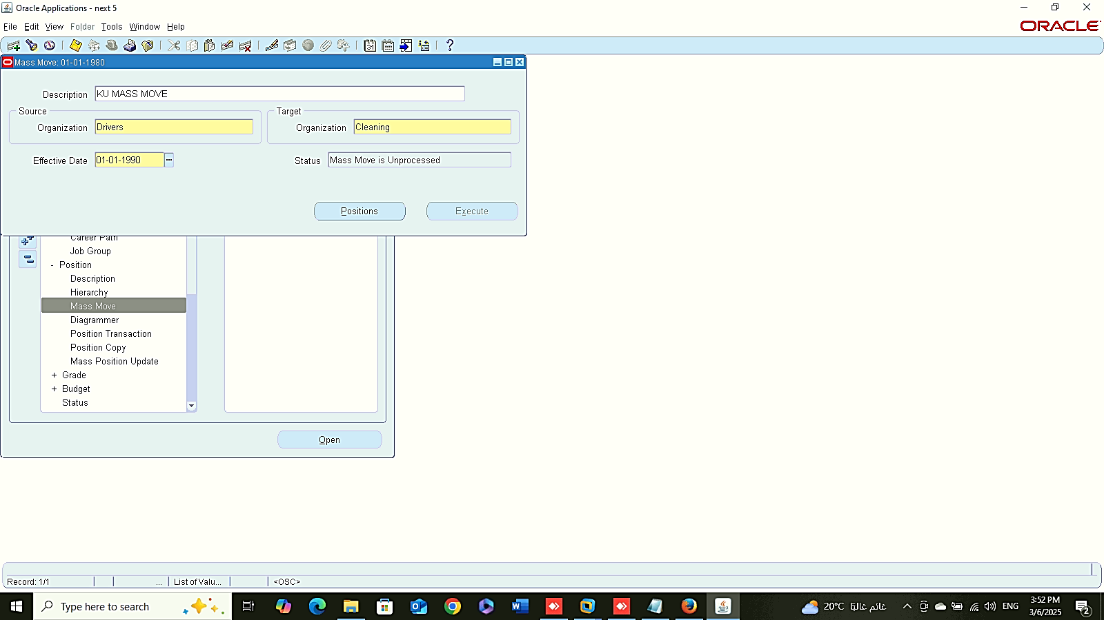
Position Hierarchy
Position Diagram
Work Structure
Setup
Position Hierarchy:
Global HRMS MANAGER > WORK STRUCTURE > POSITION > HIERARACHY
Position Diagram :
Global HRMS MANAGER > WORK STRUCTURE > POSITION > DIAGRAMMER
Mass Move Position :
Global HRMS MANAGER > WORK STRUCTURE > POSITION > MASS MOVE
Mass Move Position

Slide 9
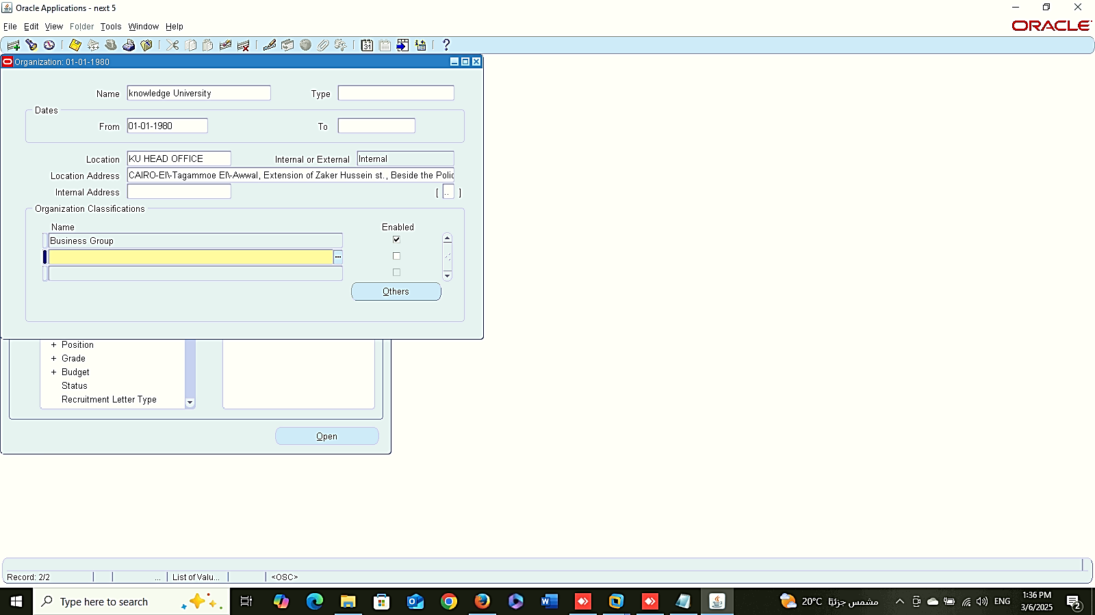
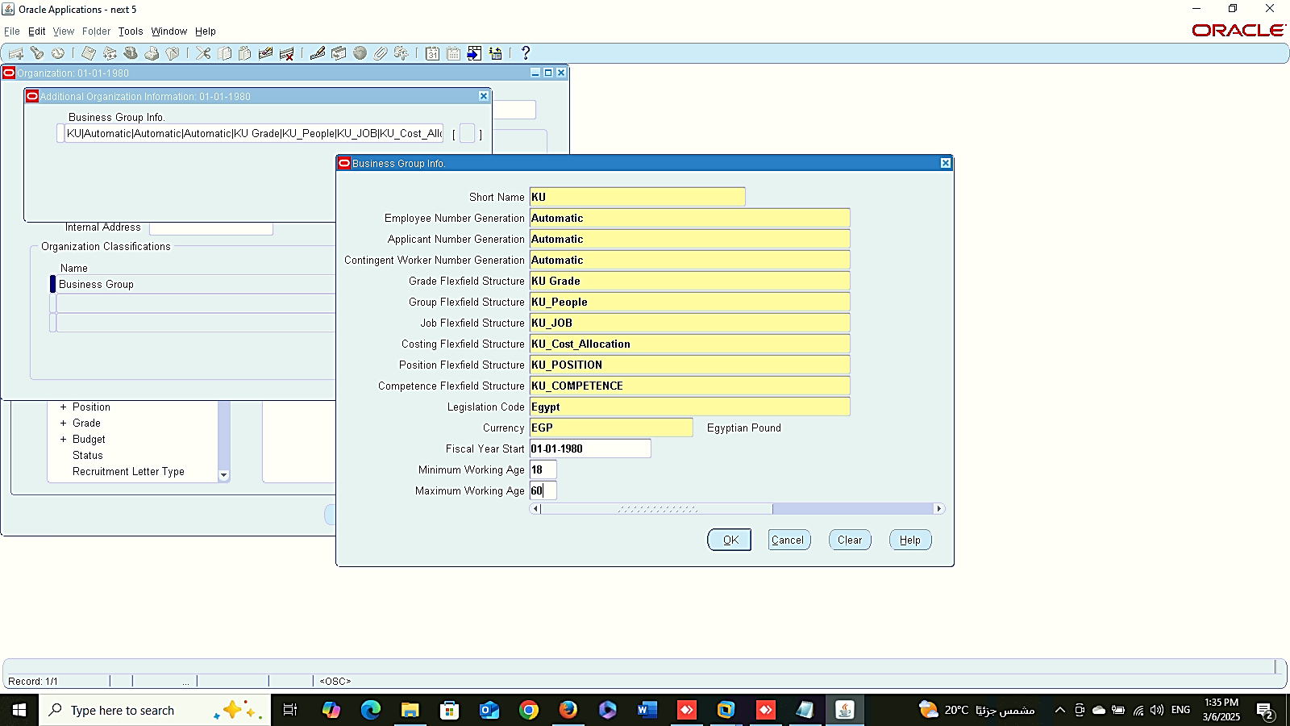
Define Business Group
1
Work Structure
Setup
Define Business Group:
Global HRMS MANAGER > WORK STRUCTURE > ORGANIZATION > DESCRIPTION
2

Slide 10
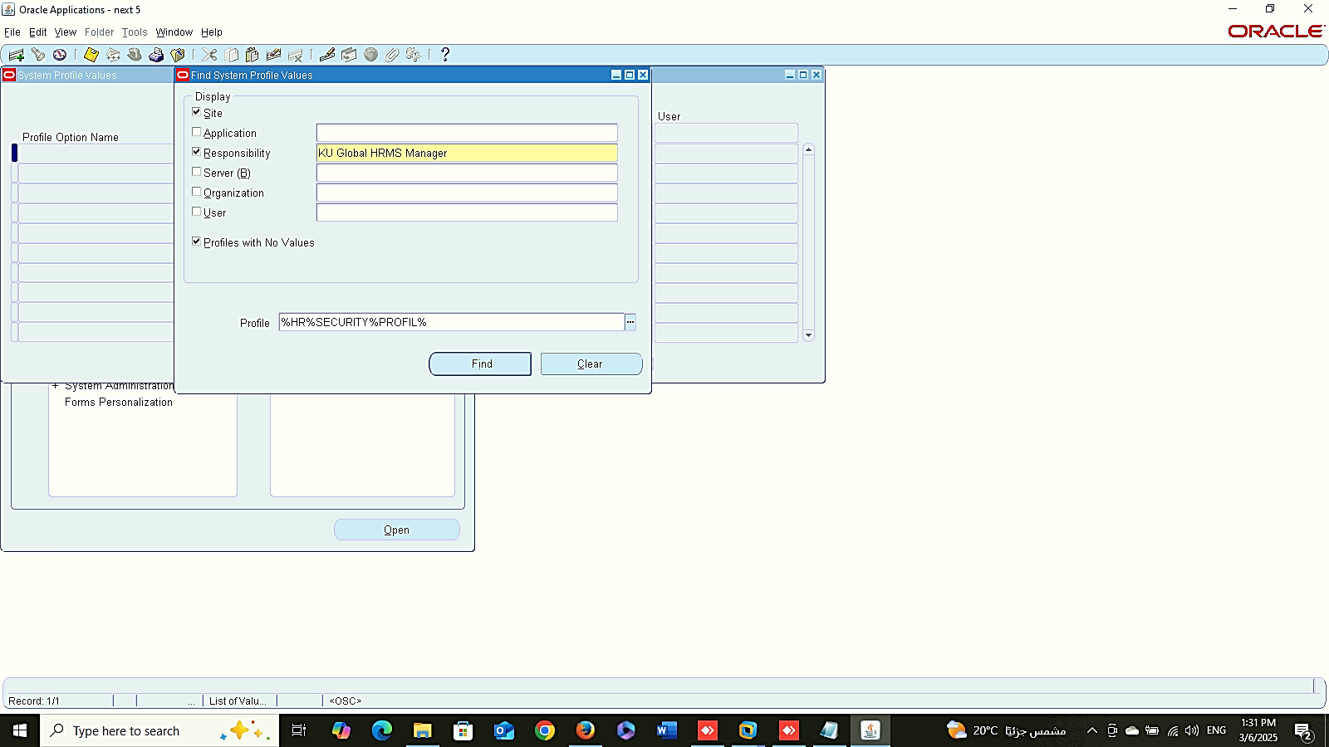
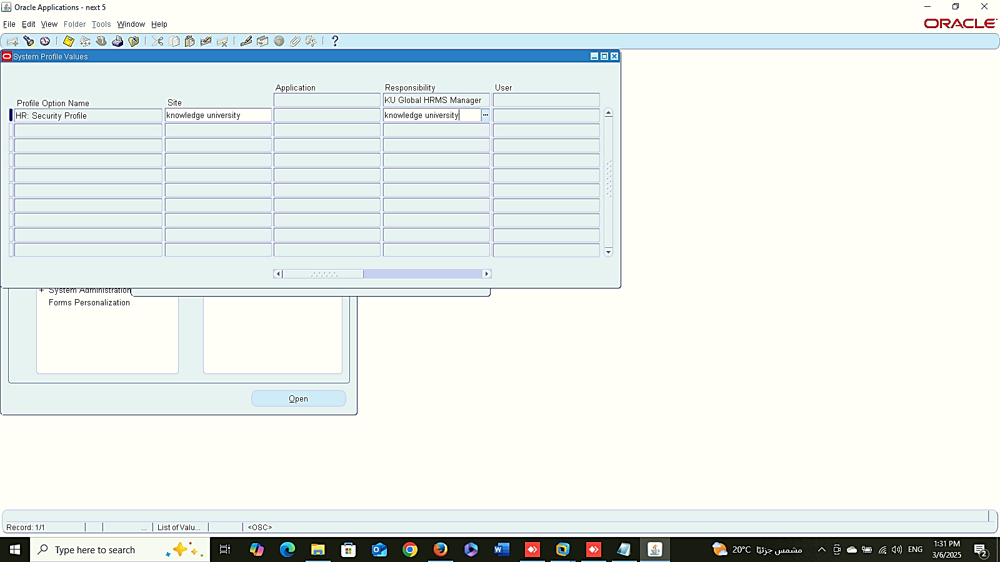
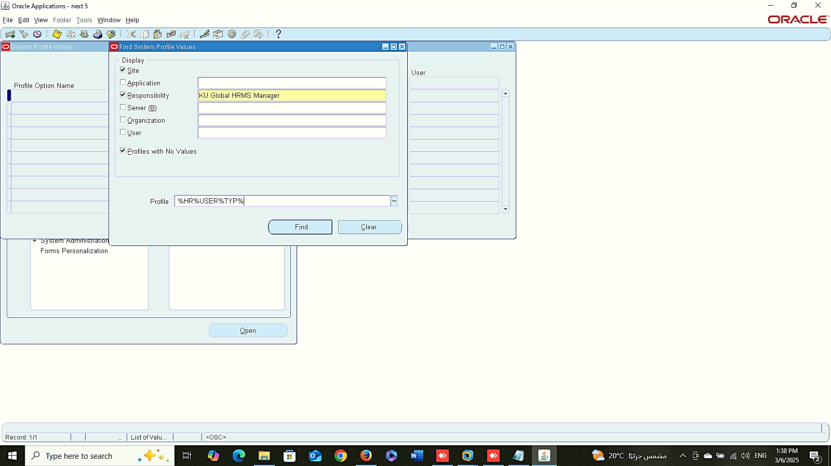
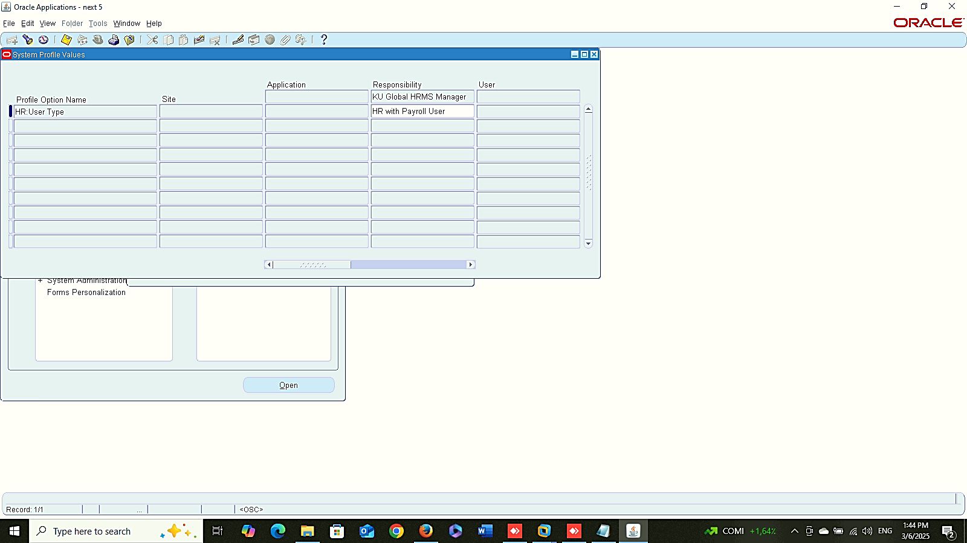
Profile Option
1
2
Work Structure
Setup
Profile Option:
system administrator > Profile> System
3
4

Slide 11
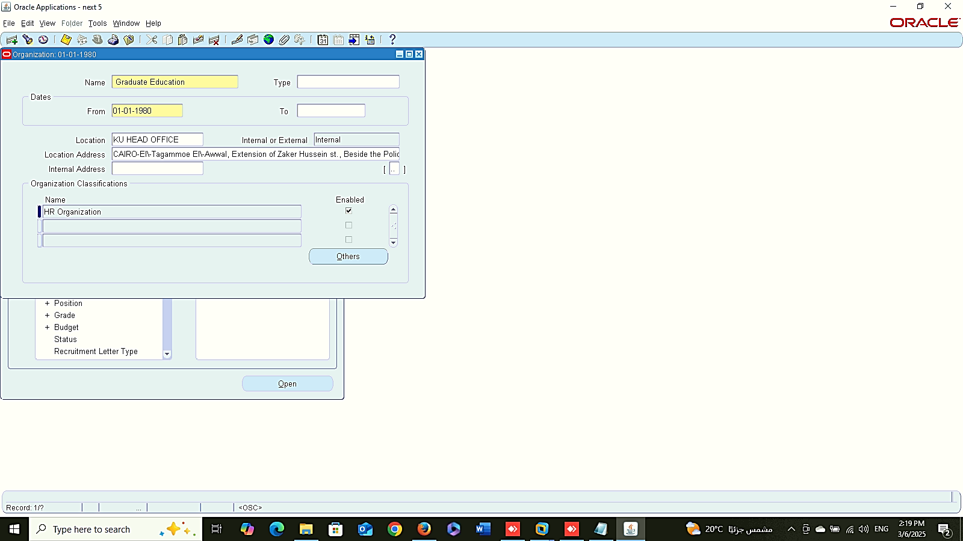
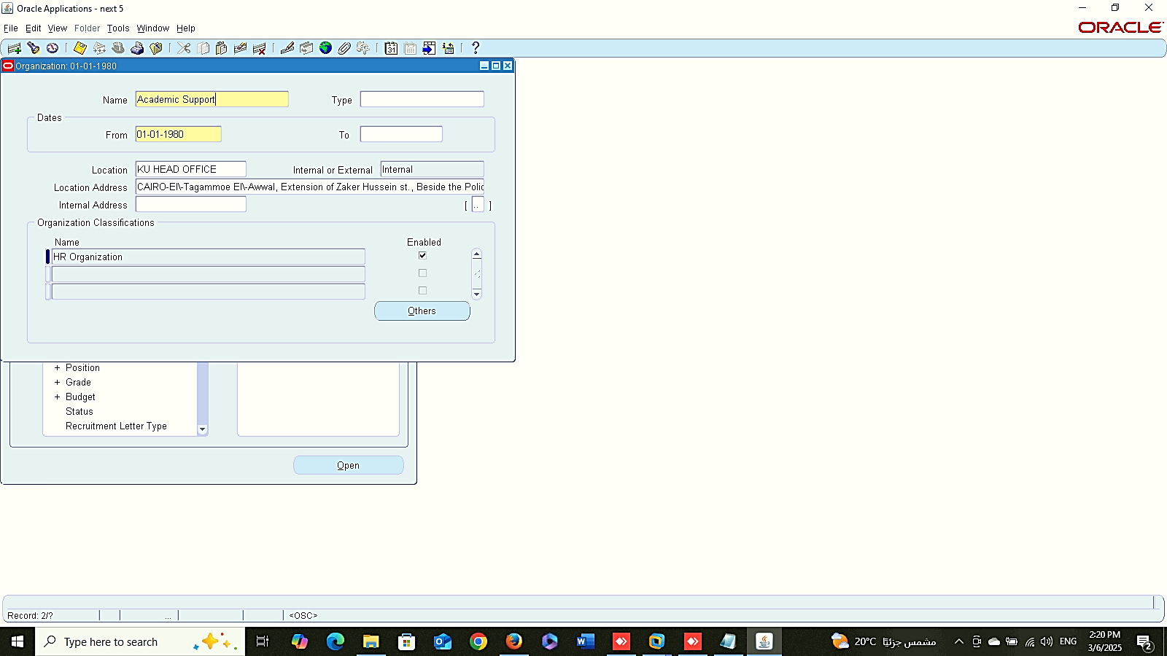

Define Organization
1
2
Work Structure
Setup
Define Organization:
Global HRMS MANAGER > WORK STRUCTURE > ORGANIZATION > DESCRIPTION
3

Slide 12

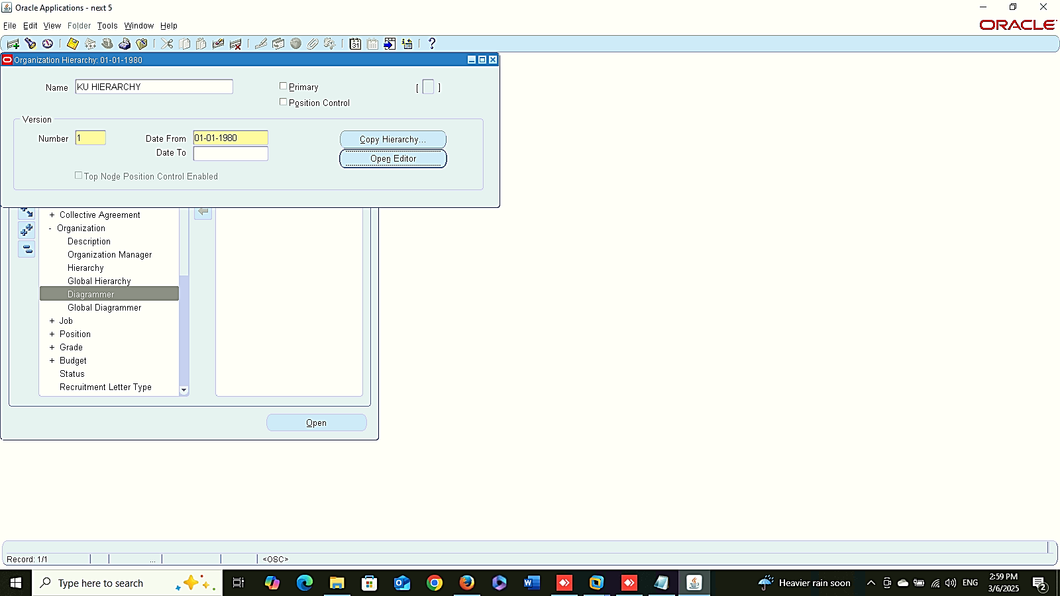
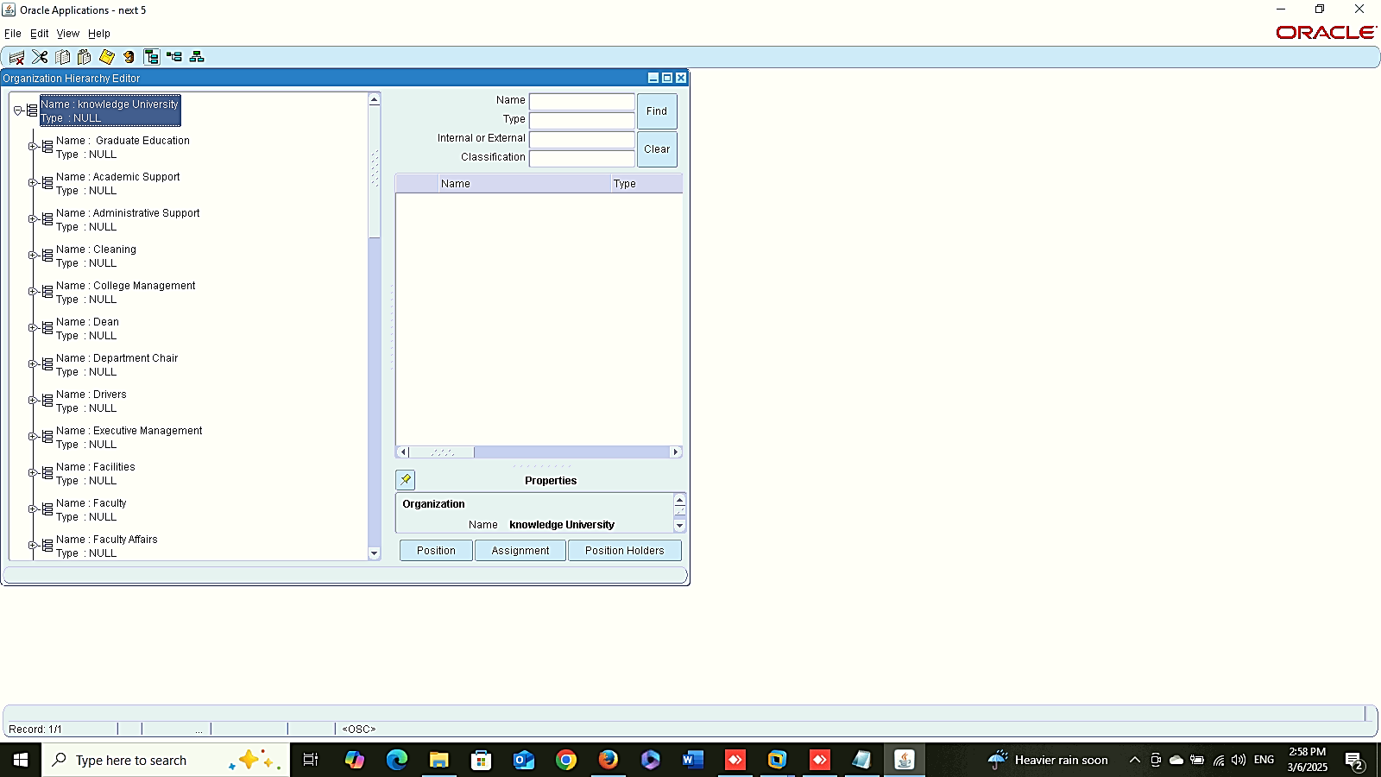
Organization Hierarchy
Work Structure
Setup
Organization Hierarchy:
Global HRMS MANAGER > WORK STRUCTURE> ORGANIZATION > HIERARACHY
Organization Diagram :
Global HRMS MANAGER > WORK STRUCTURE > ORGANIZATION > DIAGRAMMER
Organization Diagram
1
2

Slide 13
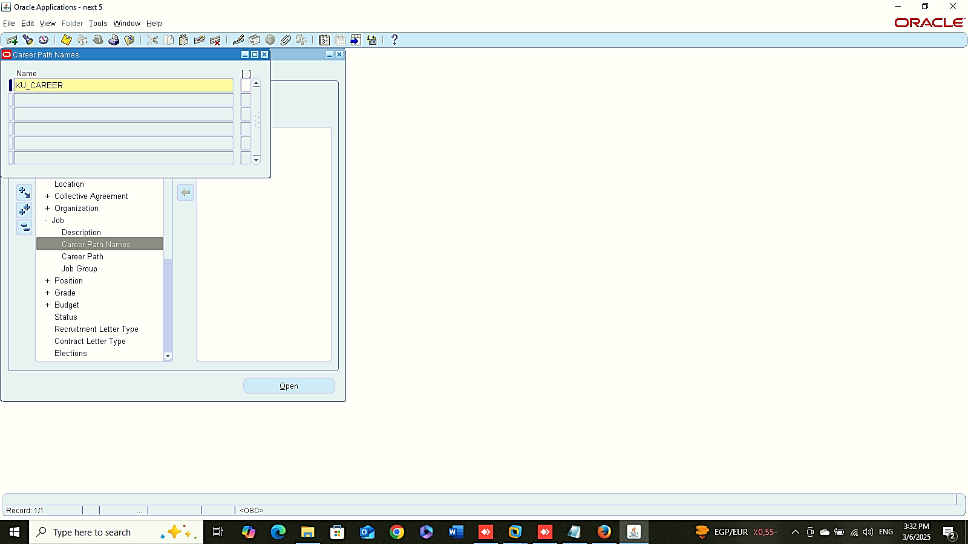
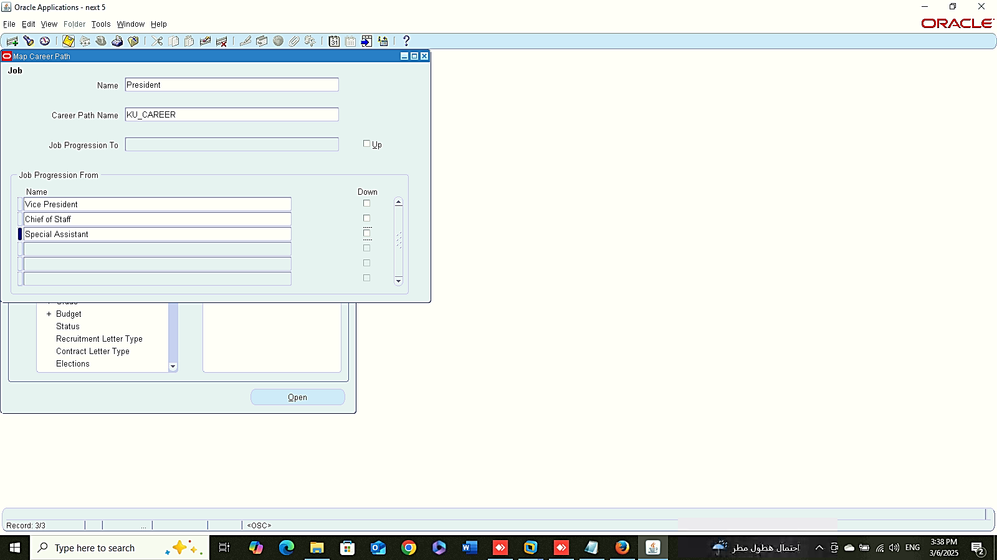
Career Path Names
Work Structure
Setup
Career Path:
Career Path Names:
Global HRMS MANAGER > WORK STRUCTURE > JOB > CAREER PATH NAMES
Map Career Path :
Global HRMS MANAGER > WORK STRUCTURE > JOB > CAREER PATH
Career Path Map

Slide 14
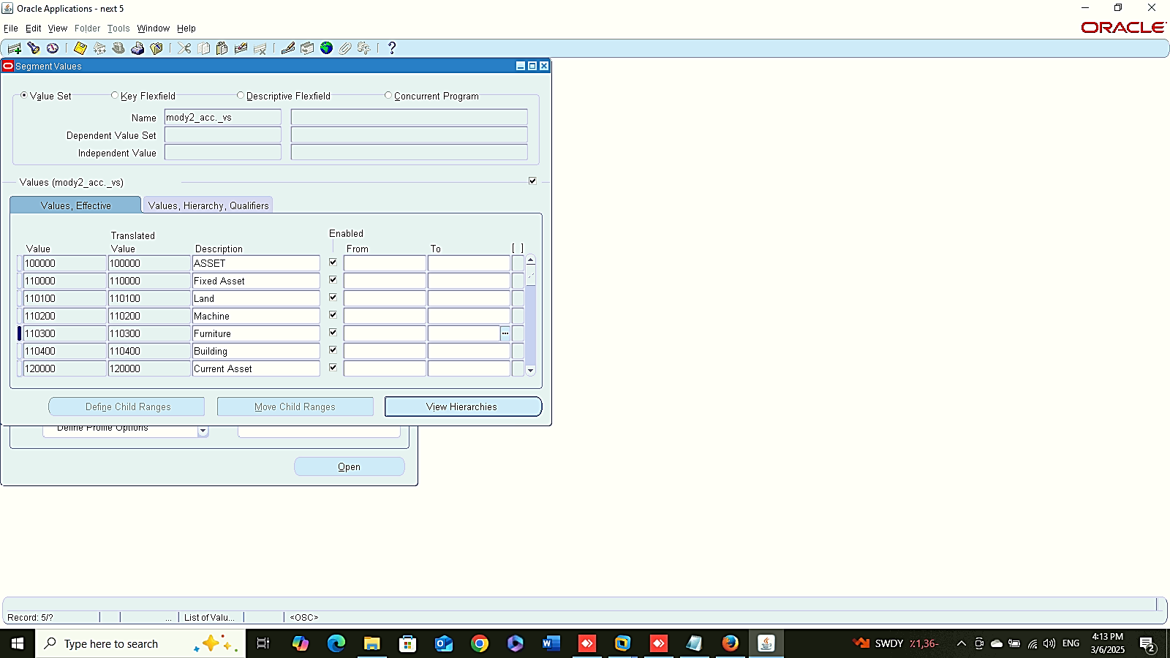


1
Work Structure
Setup
Insert Data inside Value Set:
Account
System administrator > Application > Validation > VALUE
2
3

